Slide 1

Dr. Ammar Haider
Assistant Professor
School of Computing
CS3002 Information Security
Intrusion Detection Systems

Slide 2
Intrusion
Intrusion is defined as attempt to break into or misuse an information system
Intruders may be from outside the network or from legitimate users of the network
From the perspective of IT security team, every intrusion event is an ‘incident’

Slide 3
Types of Intruders
Intruder could be outsider who is not authorized to use the computer and who penetrates a system’s access controls to exploit a legitimate user’s account.
Intruder could also be a legitimate user (usually insider) who access data, program, or resources for which such access is not authorized, or who is authorized for such access but misuses them.
In some cases, intruder seizes supervisory control of the system and uses it to evade auditing and access controls or to suppress audit collection.

Slide 4
Examples of Intrusion Attacks
Performing a remote root compromise of an e-mail server
Defacing a web server
Guessing and cracking passwords
Copying a database containing credit card numbers
Viewing sensitive data (e.g. payroll records and media) without authorization
Running a packet sniffer on a workstation to capture usernames and passwords
Using an unattended, logged-in workstation without permission

Slide 5
Intruder’s workflow
Gather information about the target
Gain initial access to the system
Privilege escalation
Do the damage e.g. steal or corrupt information, install malware
Maintain access e.g. create new accounts, install backdoors
Cover tracks

Slide 6
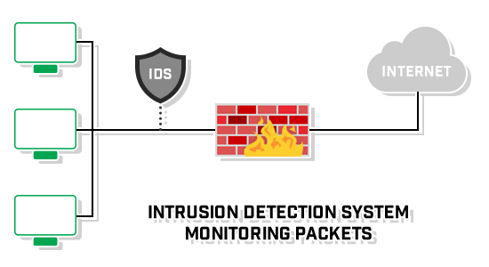
Intrusion Detection System (IDS)
A security service that monitors system events and analyzes them for the purpose of finding, and providing real-time or near real time warning of intrusion attempts.
Intrusion Detection Systems look for attack signatures — patterns that usually indicate malicious or suspicious intent

Slide 7
IDS Components
Sensors: responsible for collecting data (network packets, log files, and system call traces)
Analyzers: receive inputs from one or more sensors or from other analyzers. The analyzer is responsible for determining if an intrusion has occurred.
User Interface: enables a user to view output from the system or control behavior of the system.

Slide 8
IDS Benefits
If an intruder is detected quickly enough, the intruder can be identified and ejected from the system before any damage. Even if the detection is not that quick, the sooner the intrusion is detected, the less the amount of damage and more quickly the recovery can be achieved.
An effective IDS can serve as a deterrent, thus acting to prevent intrusion.
Intrusion detection enables the collection of information about intrusion techniques that can be used to strengthen intrusion prevention measures.

Slide 9
Effectiveness of an IDS
Practically an intrusion detection system needs to detect a substantial percentage of intrusions while keeping the false alarms rate at an acceptable level.
if too few intrusions detected → we get a false sense of security
if too many false alarms → staff ignore them, or waste time while analyzing the false alarm
Intruder Behavior
Authorized User Behavior

Slide 10
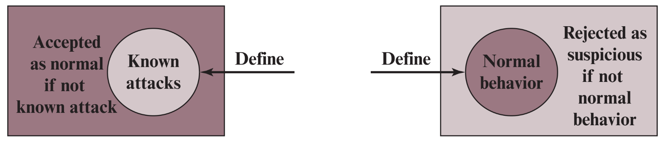
IDS Analysis Approaches
Two main approaches to analyze sensor data:
Signature based detection
Anomaly based detection

Slide 11
Signature Based Detection
Examine the sensor data, looking for already known intruder attack patterns (signatures).
The question of what information is relevant to an IDS depends upon what it is trying to detect.
e.g. attacks against DNS, FTP, IMAP etc.
New attack patterns must continually be added to the IDS’s database of signatures
Novel attacks (with previously unknown signatures) are NOT detected.
Note: Do not confuse it with cryptographic signatures

Slide 12
Signature examples
MD5 hash of a malware file
Specific byte sequences in email attachment indicating it is an executable
Malicious commands executed by a process
e.g. rm –rf / in Unix to delete all files
Protocol abnormalities in packets
e.g. TCP packets with both SYN and FIN flags set
Web packets going to URL of a known phishing sites, or accessing URL commonly associated with malwares
e.g. substring ‘phf’ in http request ‘GET /cgi-bin/phf?’, identifies those network packets as vehicles of an attack.
Note: Do not confuse it with cryptographic signatures

Slide 13
Anomaly Based Detection
Involves a collection of information about legitimate user’s behavior over a period of time. Then, statistical tests or machine learning techniques are applied to observe them.
Anything distinct from the usual behavior is assumed to be an intrusion activity.
e.g. flooding a host with lots of packet.
Primary strength of anomaly-based approach is its ability to recognize novel attacks.
But such IDSes can generate many false alarms and hence reduce their effectiveness.

Slide 14
Example metrics to observe
Number of logins during an hour
Number of times a command executed
Number of outgoing messages
Length of time between two events e.g. successive logins
Quantity of resources (CPU, memory, printer etc.) used

Slide 15
Rule-based heuristic identification
A third approach is also sometimes used
create rules for the normal usage pattern
rules can be made based on
expected behavior (ask system administrator)
experience (by analyzing historical audit records)
well known attacker behaviours (reported in research)
any deviation from the baseline is considered intrusion
like statistical anomaly detection, it does not require prior knowledge of security flaws

Slide 16
Rule-based heuristic identification
it requires a large database of rules to be effective
rules are static, and need to be updated manually
unlike anomaly based detection, a training phase is not required
Examples rules:
Users should not be logged in more than one session
Users do not make copies of system, password files
Users who log in after hours should access the same files they used earlier

Slide 17
Where to install an IDS?
Host-based IDS
Monitors the characteristics of a single host and the events occurring within that host for suspicious activity.
Network-based IDS (NIDS)
Monitors network traffic for particular network segments or devices and analyzes network, transport, and application protocols to identify suspicious activity.

Slide 18
Host/Applications based IDS
Watch the host OS or the application logs in the audit information.
These audit information includes events like the use of identification and authentication mechanisms (logins etc.), file opens and program executions, admin activities etc.
This audit is then analyzed to detect trails of intrusion.

Slide 19
Host based IDS: Drawbacks
The kind of information needed to be logged in is a matter of experience.
Unselective logging of messages may greatly increase the audit and analysis burdens.
Selective logging runs the risk that attack manifestations could be missed.

Slide 20
Host based IDS: Strengths
Can determine exactly which processes and user accounts are involved in a particular attack
Can see the exact intended outcome of an attack attempt
Can detect both external and internal intrusions
Helps in monitoring key components
Near real-time detection and response
No additional hardware needed

Slide 21
Network based IDS
A network-based IDS monitors traffic at selected points on a network or interconnected set of networks.
It examines the traffic packet by packet in real time or close to real time in order to detect intrusion patterns.
A filter is usually applied to determine which traffic will be discarded or passed on to an attack recognition module. This helps to filter out known non-malicious traffic.

Slide 22
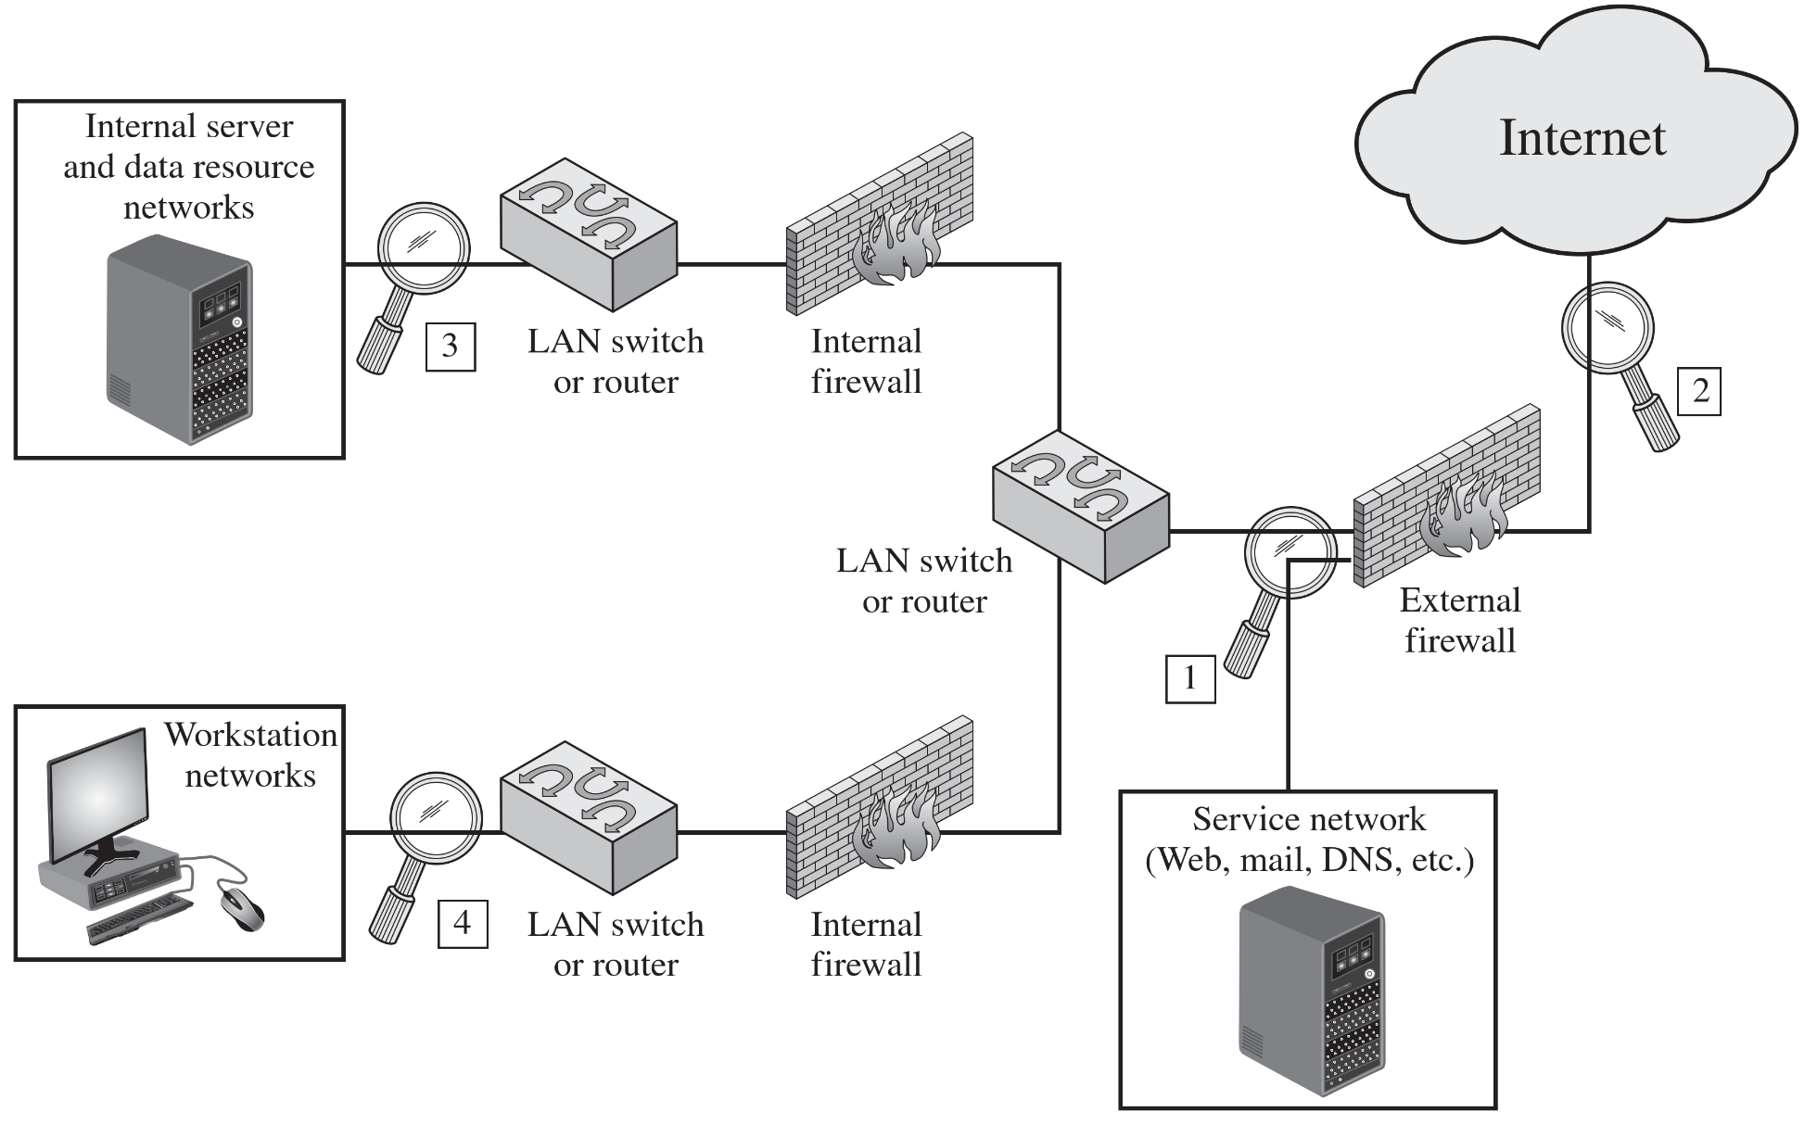
NIDS Sensor Placement

Slide 23
Network based IDS: Strengths
Cost of ownership reduced
no per-host license
Packet analysis
Real time detection and response
Malicious intent detection
Operating system independence

Slide 24
Honeypots
Decoy systems that designed to lure a potential attacker away from critical systems
An asset that solely exists to be attacked
It could be an individual item, a system or entire network
It could be a real system or emulated.
Purpose
Divert an attacker from accessing critical systems
Collect information about the attacker’s activity
Helps in IDS learning about new threats
Engage the attacker to stay on the system long enough for administration to respond

Slide 25
Honeypots
Decoy Files
Used as a “marker”
In case of an access, read, copy, or deletion, it serves as an alert to monitors
It could be anything: file, database, picture, email, account, etc.
Normally used to deliver bogus information to attackers
Honey net
Collection of two or more honeypots/decoy devices
Could be at the same location or distributed
Managed by same entity

Slide 26
Honeypot Interaction Level
It is the capability to mimic a real asset or object.
High – More realistic that mimics real, legitimate computer or device with applications, activity, and changing content
Needed for more hacker interaction, intent, etc.
More involved setup and maintenance
Low – Does very little to mimic real, legitimate device
Usually just TCP/IP port advertising or basic logon prompts
For early warning honeypots. Quicker setup, less ongoing maintenance, less risk
If you can actually logon to a decoy, then you’re at least at Medium interaction

Slide 27
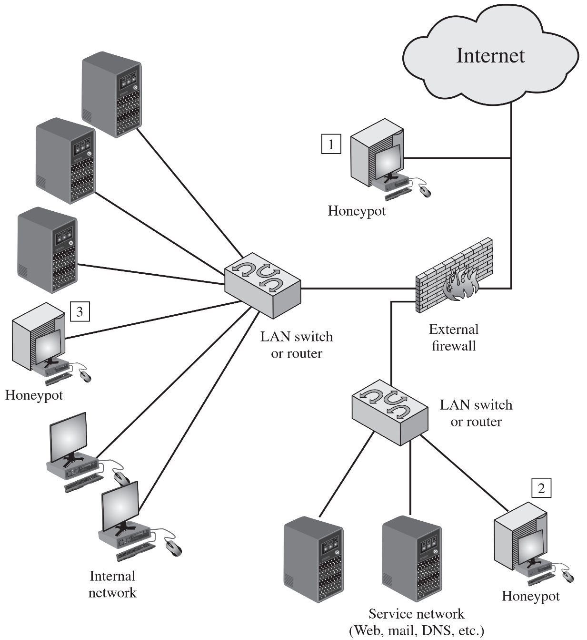
Honeypot deployment example

Slide 28
Deception Technology
Honeypots are limited in scope
It uses static decoys which adversary starts to understand
requires expensive resources to implement and maintain
Deception technology is a proactive cyber defense system through the use of decoys to lure, detect and defend, without the issues of scalability, skills and available resources.
Uses automated dynamic traps generated by AI
Immediate alerts with minimum false positive rates
Deploy traps according to the behavioral patterns of the hacker
Provide detailed reports for post cyber defense investigation

Slide 29
References
Stallings SPP chap 8

Slide 30
Specification-based Detection
The desirable behavior of a system is described through its functionalities and through the security policy. Any sequence of operations executed outside of the system’s specifications is considered to be a security violation
Use of manually specified program behavioral specifications is the basis to detect attacks
It has been proposed as a promising alternative that combine the strengths of misuse detection (accurate detection of known attacks) and anomaly detection (ability to detect novel attacks)
The development of the specifications is an expensive and tedious process and specifications are often very difficult to evaluate and verify.

